Slide 1
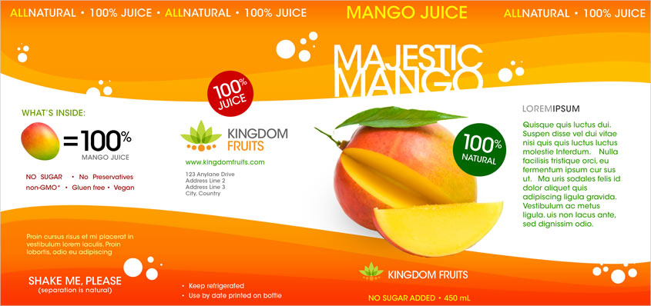
Harmony
The use of the yellow text helps to harmonise with the rest of the colour scheme of the label. Making the word ‘ALL’ a different colour from the word natural creates emphasis on that word.
Reverse text
Helps to create contrast with the orange background. This helps the product name to stand out.
Alignment
The words along the top of the label are all aligned with each other. This helps to make them easier to read. The words are also repeated three times which means that they can still be read when the bottle is turned.
Rotate
Rotating the text within the circles helps to create contrast with the rest of the text in the label which is horizontal and helps to create visual interest.
Depth / Dominance
The image of the mango is overlapping the wavy flashbar. This makes it appear closer that the flashbar which makes it look more 3D.
Making the mango the largest item on the page helps to make it the most dominant and therefore the focal point of the label.
Harmony
The use of the orange, yellow and yellow-orange colours for the wavy flashbar help to create harmony with the colours in the mango.
Using these colours reoeatedly helps to create unity within the layout.
Alignment
The body text in green is aligned with the heading above it. This helps to organise the layout and make the text easier to read.
Repetition
Repeating these white circles throughout the layout helps to create unity.
Repeating the larger red and green circles also helps to create unity in the layout.
Balance
The label is asymmetrically balanced due to the lack of symmetry. This helps to make the label more visually exciting which is important for product packaging.
Colour
The body text is in green which ties in with the green of the leaf on the mango. It is also the same colour as the circle which says ‘100% natural’ which helps to create unity in the label. The colour green is a good choice for the list of ingredients as it will make people associate it with health.

