Slide 1


Computer Aided Design & Draughting
Graphic Communication
Name: ………………………………………………………… Class:……………… Teacher:…………………………………………..

Slide 2
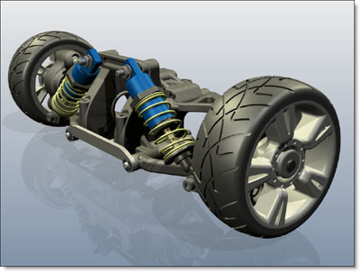
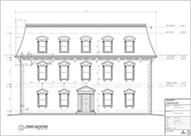
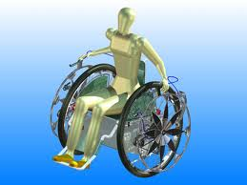
What is CADD
Computer Aided Design/ Draughting is the use of computer systems to assist in the creation, modification, analysis, or optimization of a design. Computer-aided drafting describes the process of creating a technical drawing with the use of computer software. CAD software is used to increase the productivity of the designer, improve the quality of design, improve communications through documentation, and to create a database for manufacturing. As in the manual drafting of technical and engineering drawings, the output of CAD could convey information, such as materials, processes, dimensions, and tolerances.
Who uses it?
CAD is an important industrial art extensively used in many applications, including automotive, shipbuilding, and aerospace industries, industrial and architectural design, prosthetics, and many more. CAD is also widely used to produce computer animation for special effects in movies, advertising and technical manuals.

Slide 3
What are the advantages of CADD?
Drawing speed
Although it takes a considerable amount of time and financial investment by companies to train their CADD operators. It will save time in the long term as drawing production is more accurate much faster using CADD software opposed to traditional methods. Files can also be sent instantly through emails. In turn, this will help increase productivity generating more income for companies.
Ease of modification
Companies who use CADD systems have advantages over competitors who rely on more traditional methods of modifying drawings. The ease and speed with which modifications can be made reduce time and costs, which in turn increases productivity.
Drawing size and flexibility
Drawings can be enlarged or reduced with no loss of detail. Extremely fine, detailed work can be produced using commands such as ZOOM. Positive location tools such as GRID, GRID SNAP and ATTACH enable accuracy to be maintained even in the smallest details.
Repetitive elements (library)
Drawings can contain a number of repetitive elements such as doors, windows, kitchen fittings and appliances. It is useful to have these items stored in a CAD library file. CAD library files are available for mechanical engineering, architecture and electronics. Items that you design need only be drawn once, saved to a library file, then retrieved and positioned each time they are required on a drawing. This saves time and effort, which increases productivity.
Storage and retrieval
A completed drawing or series of drawings can be stored on a hard drive, removable USB storage device or CD-R. These formats require less storage space than paper drawings. The drawings can then be printed as many times as required with no deterioration in quality.
Standardisation of drawings
Standardisation of drawings is often determined by drawing standards such as BS 8888. Standardisation of drawing layouts and styles can easily be created in the 'in-house' or corporate style adopted by the operator or the company.

Slide 4
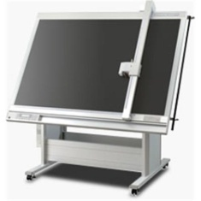
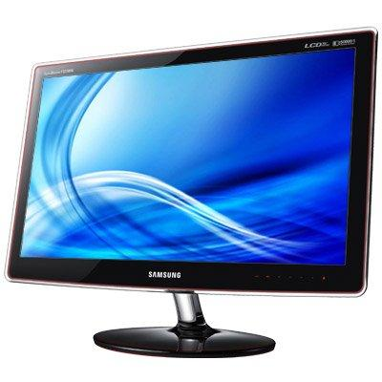
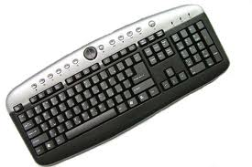
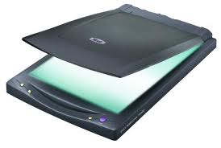
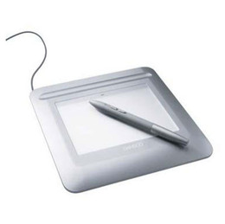
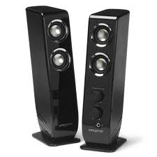
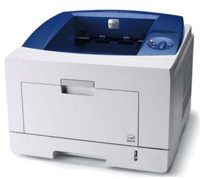
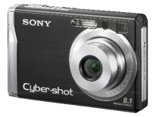
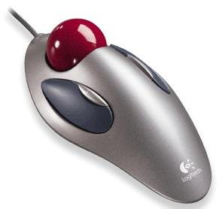
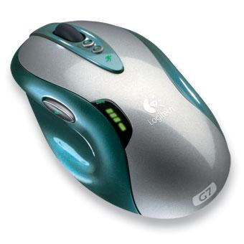
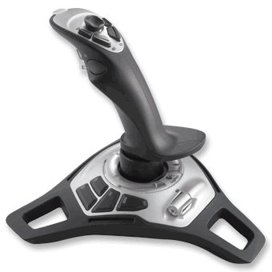
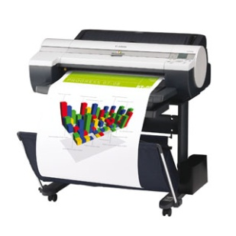
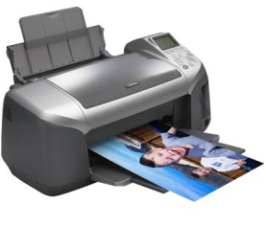
Hardware & Software
Computer systems use a combination of hardware and software to perform tasks. Hardware is the name given to the physical part of the system, both internal (CPU, RAM etc) and external (keyboard, monitor etc). Software is the name given to the programs which interact with the hardware, enabling the computer to perform tasks, eg, Autodesk Inventor.
Hardware can be split into two distinct categories; Input devices and output devices
Flatbed Plotter
Scanner
Keyboard
Monitor
Digital Camera
Input devices
Output devices
Graphics Tablet
Speakers
Laser Printer
Mouse
Tracker ball
Joystick
Inkjet Printer
Drum Plotter

Slide 5
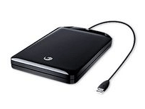
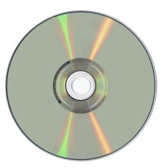

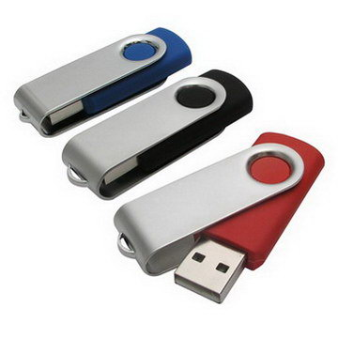
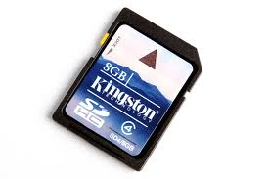
Storage
A PC usually contains several disk drives; an internal hard drive and one or more removable-disk drives. Whilst the internal hard drive is used for most general day to day storage of work, removable discs also have their advantages:
Copying/moving files – when computers are not connected by a network, the easiest way to transfer files from one computer to another is by copying the file onto a removable disk which can be opened on another computer.
Backing up files – Back up copies of important files can be taken as insurance in case any of the original files are corrupted or accidentally deleted
Archiving file – When files are no longer needed, they can be stored on a removable disc and removed from the computers internal hard drive. This frees up valuable storage space on the hard drive.
Removable hard drive
Recordable Compact Disc (CD-R)
Removable
Storage Devices
Digital Versatile Disc (DVD)
USB Removable storage device
Memory Card

Slide 6
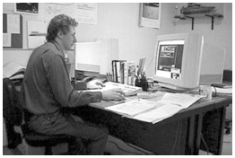
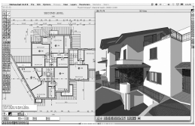
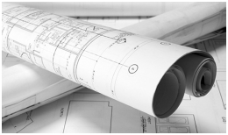
Exercise 1
Other than speed of production, describe three other advantages that would be beneficial to architects by using computers for their graphics needs compared with traditional manual methods of production.
a) …………………………………………………………………………………………………..
b) …………………………………………………………………………………………………..
c) …………………………………………………………………………………………………… (3)
Other than set up costs, describe two things that could be a disadvantage of using CAD system.
a) …………………………………………………………………………………………………..
…………………………………………………………………………………………………..
b) …………………………………………………………………………………………………..
………………………………………………………………………………………………….. (2)
State the names of two types of plotters that could be used to create to hard copies of drawings produced using a CAD package.
a) …………………………………………………………………………………………………..
b) ………………………………………………………………………………………………….. (2)
Other than a digital camera, state one device that could be used to save to copy existing manual drawings to the computer’s hard drive.
……………………………………………………………………………………………………….. (1)

Slide 7
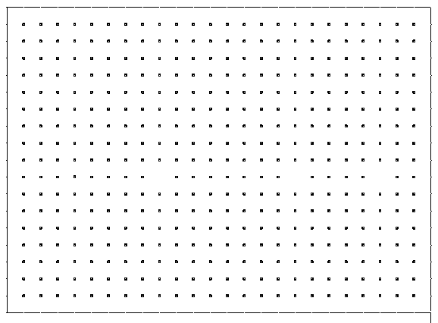
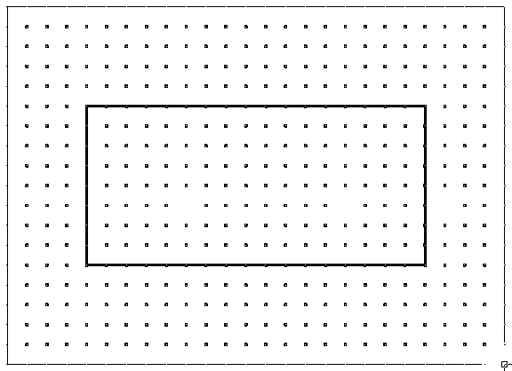
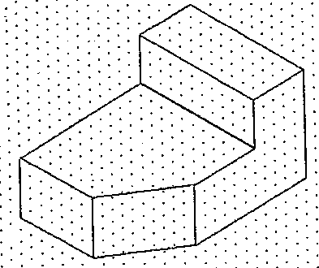
CAD Commands 1 – Grids & Grid Snap
Grid
Grid/Snap
Isometric Grid
Screen grids can be set to any size. They can make it easier to do orthographic drawings
Snap allows you to ‘lock’ on to any of the grid points
This allows isometric drawings to be generated much more easily. The grid lines are inclined at 30°
2D

Slide 8
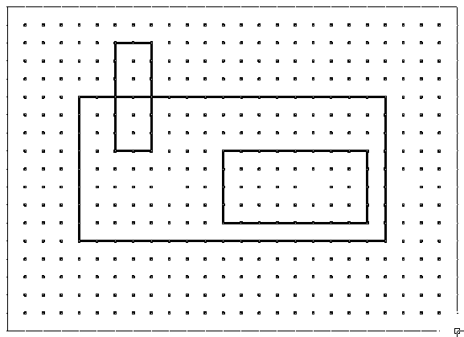
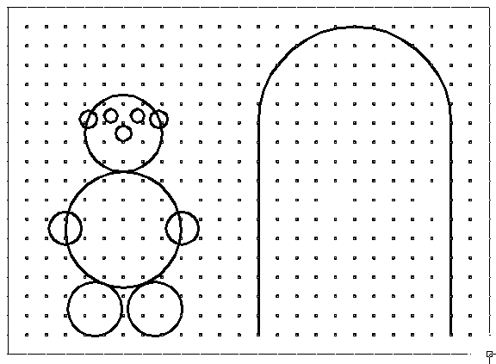
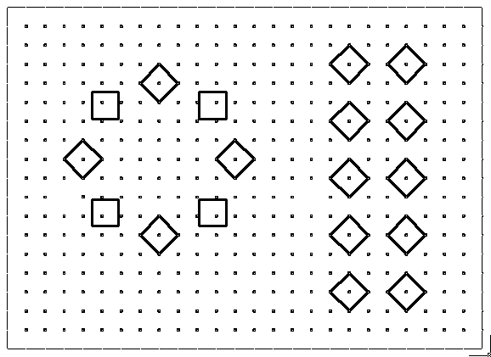
CAD Commands 2 – Shapes
Box/Rectangle
Circle
Arc
Circular Array
Box Array
Allows the drawing of rectangular shapes on screen
Allows the user to draw arcs and circles on screen
This allows the user to draw circular or rectangular arrangements from a single object
2D

Slide 9
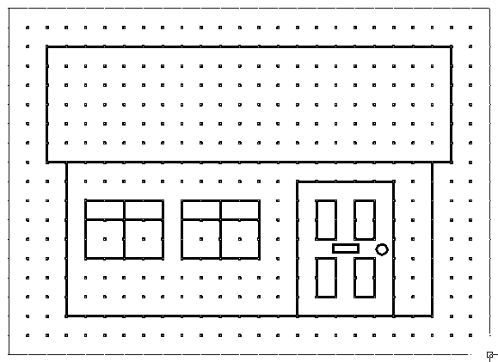
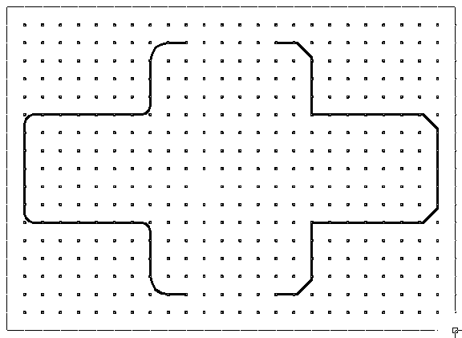
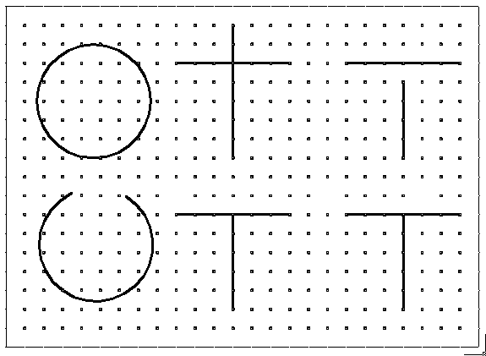
CAD Commands 3 – Modify Tools
Copy
Fillet
Chamfer
Break
Trim
Extend
Allows the user to copy and position objects or parts of a drawing without having to redraw them
Fillet puts a radius on a corner (rounded)
Chamfer puts a 45 deg angle on a corner
Trim/Break removes an unwanted section of line, etc.
Extend makes a line longer (usually to meet another object)
2D

Slide 10
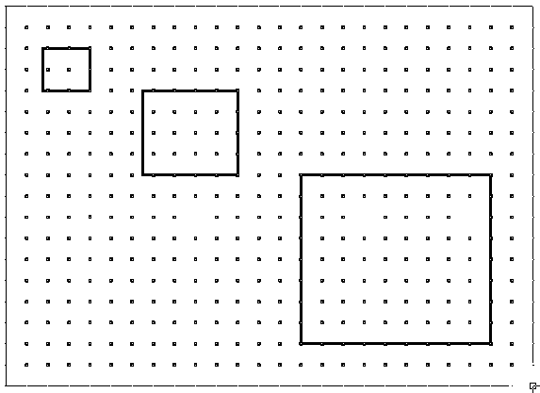
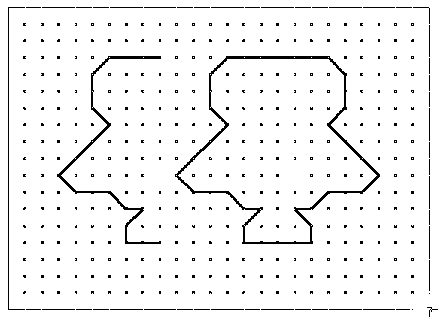
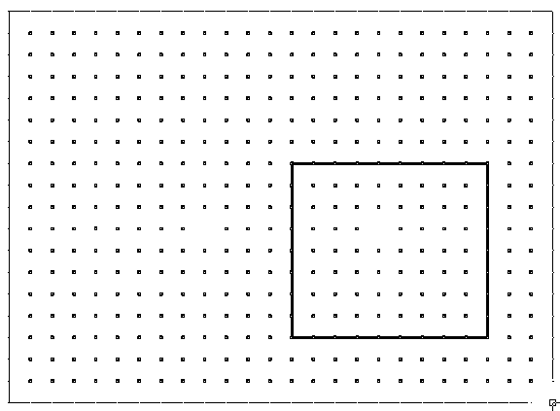
CAD Commands 4 – Modify Tools
Scale
Flip/Mirror
Rotate
This allows the user to change the size of an object without altering its proportion
This flips an object about the horizontal or vertical axis
This allows the user to turn an object at any angle about a point
2D

Slide 11
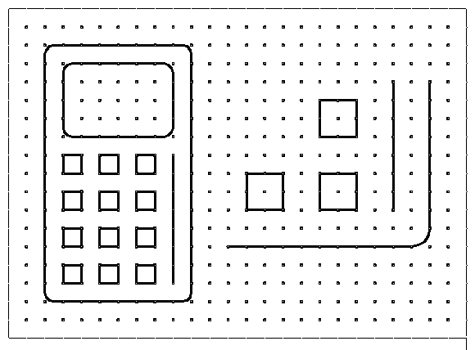
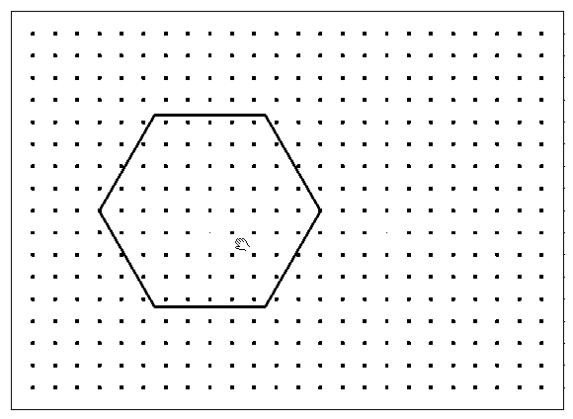
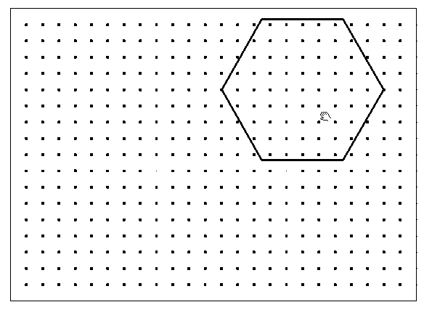
CAD Commands 5 – View Tools
Zoom
Pan (before)
Pan (after)
Allows a user to increase or decrease the screen view so that they can see detail clearer
Panning around the screen allows the user to see other parts of a drawing hidden from the visible screen. Using pan does not change the drawing size or scale.

Slide 12
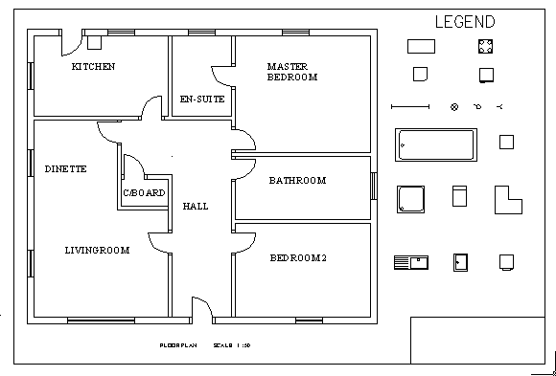
CAD Library
A Library is a useful tool which allows you to store common parts that can be added to drawings as often as required. An example of a simple computer library is shown below in relation to a floor plan. It has some of the basic BSI building symbols which can selected and placed into position as many times as necessary.
Library parts
The Advantages:
No need to draw items more than once
Drawings can be produced much quicker as there is no need for any repetition
Drawing are standardised
They can hold thousands of items
Additional items can be added at any time
Drawing are stored to their real size and scaled to suit the drawing when retrieved from the library

Slide 13
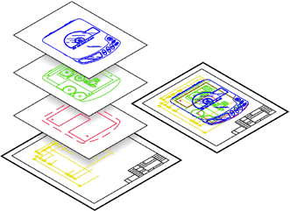
Layers
Layers are extremely useful when helping to organize your drawings. Imagine a large project for a high-rise tower of flats. The designers would have to create layers to display building, electrical, plumbing and landscape information etc. Having all of this information on one drawing would make it difficult to read and understand. By using layers, it would allow us to control the drawing and turn off some of this information (by removing the visibility of the layer) when they are not required, therefore, viewing only the information you need. This is one reason why layers are essential.
Another example may be to cross the language barrier. By having a drawing on one layer, then creating a range of layers for text and dimensions in different languages. This saves international companies a great deal of time and effort as the same drawing doesn’t need to be repeated for each language.

Slide 14
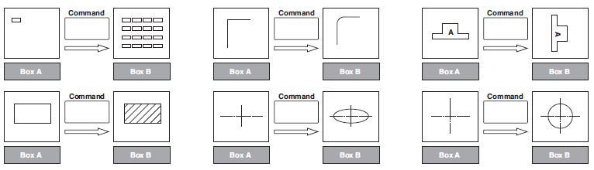
Exercise 2
The use of CAD systems is now well established in many industries that use graphics.
a) Look at the features shown in Box A and, in the space provided, state the single CAD command that could be used to change the feature to what is shown in Box B. (6)
Box A
Box B
Box A
Box B
Box A
Box B
Command:……………………………
Command:……………………………
Command:……………………………
Box A
Box B
Box A
Box B
Box A
Box B
Command:……………………………
Command:……………………………
Command:……………………………
Explain what is meant by the term back up when applied to work done using CAD.
………………………………………………………………………………………………………………………………………………………………………..
……………………………………………………………………………………………………………………………………………………………………….. (1)
State why it is good practice to make a back-up.
………………………………………………………………………………………………………………………………………………………………………..
……………………………………………………………………………………………………………………………………………………………………….. (1)

Slide 15
Computer Modelling
Types of Models
Wire Frame
Solid
Real Time
These are the main types of computer models used by designers of animation or simulation.
Models start off as ‘wire frame’ then are made ‘solid’ and finally given the image of being ‘real time’ as in a movie production or a training simulation environment.
Animation is where computer models perform as in entertainment e.g. films.
Simulation is where models create a virtual reality where humans can interact with events and change the outcome e.g. aircraft pilot training etc.
(For more information on computer animation and simulation, go to page 22)

Slide 16
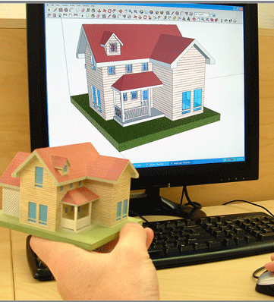
Computer Models Vs Hand/Machine Made Models
The development in 3D modeling techniques enables designers in different industries to create 3 dimensional models of their concepts quickly and easily.
Hand/Machine Made Models
These models are very useful for designers when determining how a design may look or feel before moving to the next stage of design. Previously, 3D models had to be built manually from materials such as card, clay and polystyrene blocks. Nowadays, advances in technology have enabled 3D printers to become a reality, allowing the user to produce accurate real life models. Although this gives the benefit of being able to touch and hold the model it means another model would need to be created to take into consideration any changes or modifications that may need to be made. It can also be quite time consuming to produce these models.
Computer Generated Models
These models are much quicker and easier to create and edit. Modifications can be done at the click of a button, eg . shape, colour, texture, scale, degree of accuracy. They can also be seen to function in any given environment. They obviously take up less physical space as they are stored electronically and designs can be sent instantly over the internet to clients and other designers. Unfortunately they cannot be physically touched for feel of comfort or control.

Slide 17
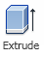
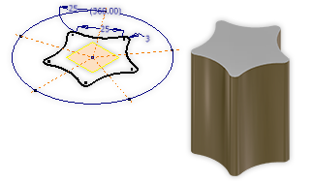
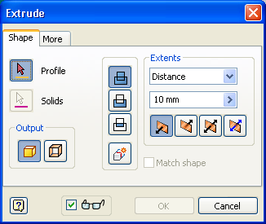
CAD Commands 5 – Modelling Tools
Extrude
The extrusion tool is used to add depth to a sketch to transform it into a 3D model as shown below
Join: Adds the volume created by the extruded feature to another feature or body.
Cut: Removes the volume created by the extruded feature from another feature or body.
Intersect: Creates a feature from the shared volume of the extruded feature and another feature.
3D

Slide 18
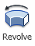
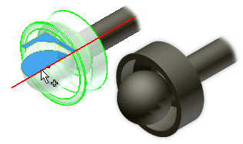
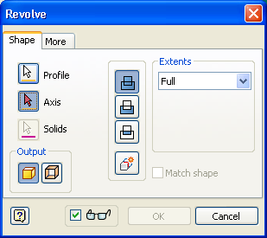
CAD Commands 6 – Modelling Tools
Revolve
Creates a 3d model or feature by revolving one or more sketched profiles around an axis.
Extents relates to the limits of the rotation, ie, is a full rotation or only rotated part way
Profile is the sketch
Axis is the centre line you want to revolve round
Join Adds the volume created by the revolved feature to another feature or body.
Cut Removes the volume created by the revolved feature from another feature or body
Intersect Creates a feature from the shared volume of the revolved feature and another feature or body.
3D

Slide 19
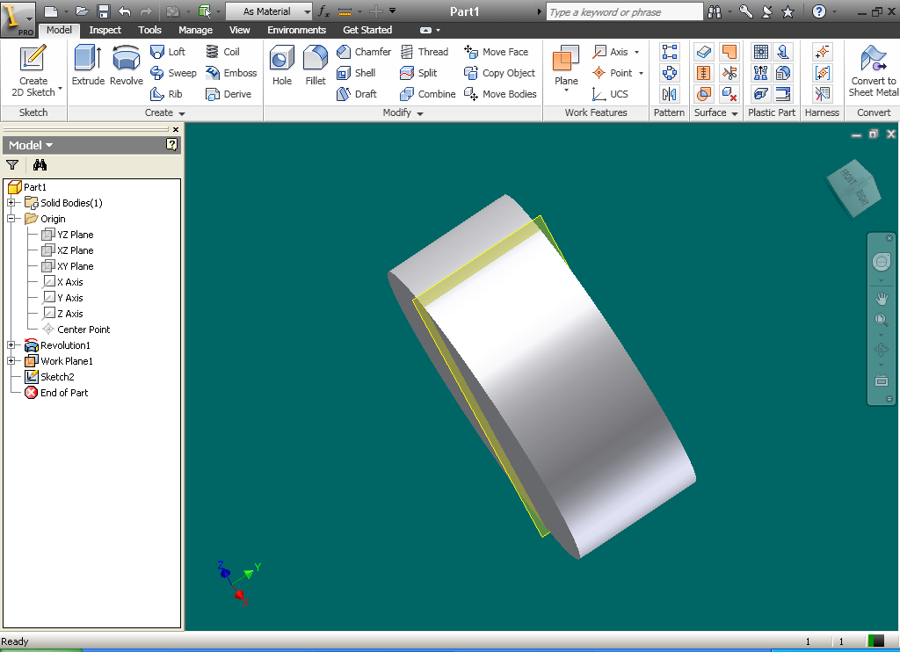
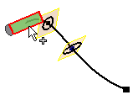


CAD Commands 7 – Modelling Tools
Loft
Sweep
Sweep models or features are created by moving or sweeping one or more profiles (sketches) along a path. If using multiple profiles, they must exist in the same sketch. The path can be an open or closed loop, but must pierce the profile plane.
Creates a model or feature by blending multiple profiles (sketches) called sections, and transitioning them into smooth shapes between the profiles or part faces.
3D

Slide 20



CAD Commands 8 – Modifying Tools
Shell
Fillet
Chamfer
The shell tool allows you to remove surfaces and hollow out any shape or feature. The wall thickness can also be edited .
The fillet tool allows you to round any selected corner or edge on a model. Multiple edges and corners can be filleted at any one time and the size of the fillet can be easily edited.
The chamfer tool allows you to remove an angular section along any selected corner or edge. Again, multiple edges/corners can be chamfered at any one time and the size can be easily edited
3D

Slide 21






Exercise 3
The marker lid opposite was constructed on CAD software. Answer the following questions to explain how it was created.
After the initial sketch of a circle was created, state which tool was used to transform it in to the 3D object shown on the right:
Tool: …………………………………………………………..
Next, the top edge of the cylinder was rounded to make it look more realistic, as shown on the right. What tool was used for this process:
Tool: …………………………………………………………….
The cylinder was rotated upside down and hollowed out (as shown opposite) to allow space for the main body of the pen to fit inside. What tool was used for this process:
Tool: …………………………………………………………….
To attach on the clip, we had to create a flat area for us to sketch on, this is shown in the diagram opposite. What is the name of this feature:
Feature: ……………………………………….
5. Using the space below, describe how the clip was created and modified:
……………………………………………………………………………………………………………………………………………………………………………………………………………………………………………………………………………………………………………………………….

Slide 22





CAD Commands 9 – Inventor Studio
Within Inventor, you will find ‘Inventor Studios’ in the ‘Environments’ tab.
This part of the software, allows you to create a more realistic image of your work through the use of materials, scenes and light sources.
(Basic Image)
Materials
Lights
Scene
Your model can be quickly and easily enhanced by selecting appropriate materials for different parts of your inventor model.
Each material choice can be edited to make it more unique and even more realistic.
Adding lighting allows you rendered image to take on shadows and reflections. You can choose from preset styles or make your own to produce a high quality effect.
Adding a scene allows you to incorporate a background colour or image to enhance your presentation. Scenes are only visible during editing and the rendering process.
3D

Slide 23


Animation and Simulation
Introduction
The development of technology and computer software has changed the way in which graphics can be produced. Recent advances have enabled designers to create complex and realistic graphic images quickly and easily. Two examples of this are animation and simulation.
Computer Animation
Computer Simulation
Animation allows a designer to create on-screen movement of graphic images along a set path (to form a video clip). It is quick and easy to produce a realistic impression and is used to increase visual impact of graphics on the viewer. A product with moving parts can be animated to demonstrate how it fits together and operates.
Computer simulation is used to imitate or predict behaviour in a real life or hypothetical situation. This provides a virtually realistic experience for the user within a safe simulated environment. By changing the variables within the software, predictions can be made about the behaviour of a
system.
Computer simulation
is beneficial for
training purposes,
eg, 3D simulators
are commonly used
to train pilots how
To manoeuvre their
planes in dangerous
conditions.

Slide 24

Exercise 4
Animation, simulation and computer modelling are now widely used in many industries.
Describe the main difference between animation and simulation.
Answer …………………………………………………………………………………………………………………………
………………………………………………………………………………………………………………………… (1)
Racing drivers use simulators to train.
State two advantages of using a simulator while training to be a
racing driver.
1 ………………………………………………………………………………………………………………………
2 ……………………………………………………………………………………………………………………… (2)
When designing a new racing car, concepts can be tested using simulations.
State one way in which computer simulation can help when designing a new racing car.
Answer …………………………………………………………………………………………………………………………
………………………………………………………………………………………………………………………… (1)
Computer animation is now used in the architectural industry when producing new building designs. State how computer animation of a new design could be used by the architect.
Answer …………………………………………………………………………………………………………………………
………………………………………………………………………………………………………………………… (1)

Slide 25
Exercise 4 (continued)
State one other industry that uses computer animation and give an example of its use.
Industry …………………………………………………………………
Example .........................................................................
.................................................................................... (2)
State one advantage and one disadvantage of computer modelling
of a new building design.
Advantage ……………………………………………………………………………………………………
……………………………………………………………………………………………………………
……………………………………………………………………………………………………………
Disadvantage ………………………………………………………………………………………………….
…………………………………………………………………………………………………………… …………………………………………………………………………………………………………… (2)
7. State the names of two types of computer generated model.
Model 1 ........................................................
Model 2 ........................................................ (2)

