Slide 1
N5
Name: ____________
Class: ____________
Teacher: ____________
EXAM
Revision
CAD

Slide 2
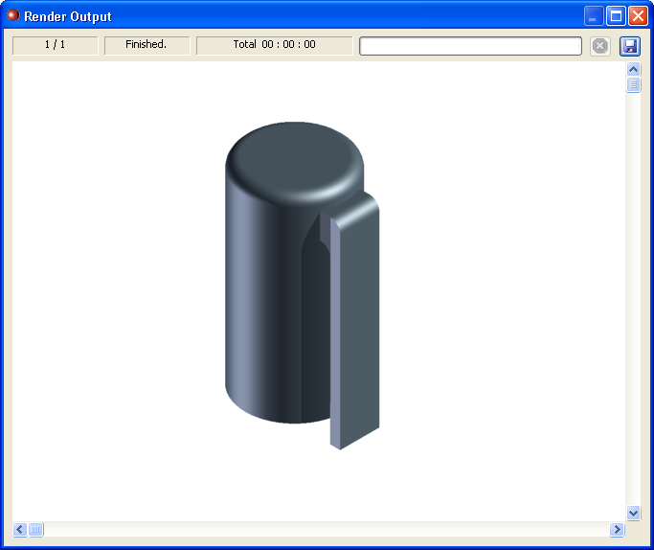
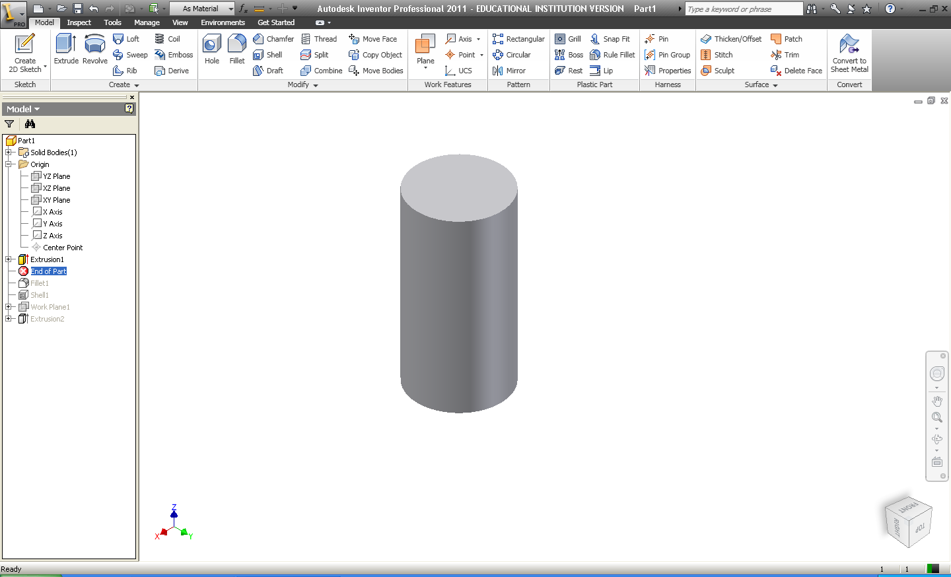
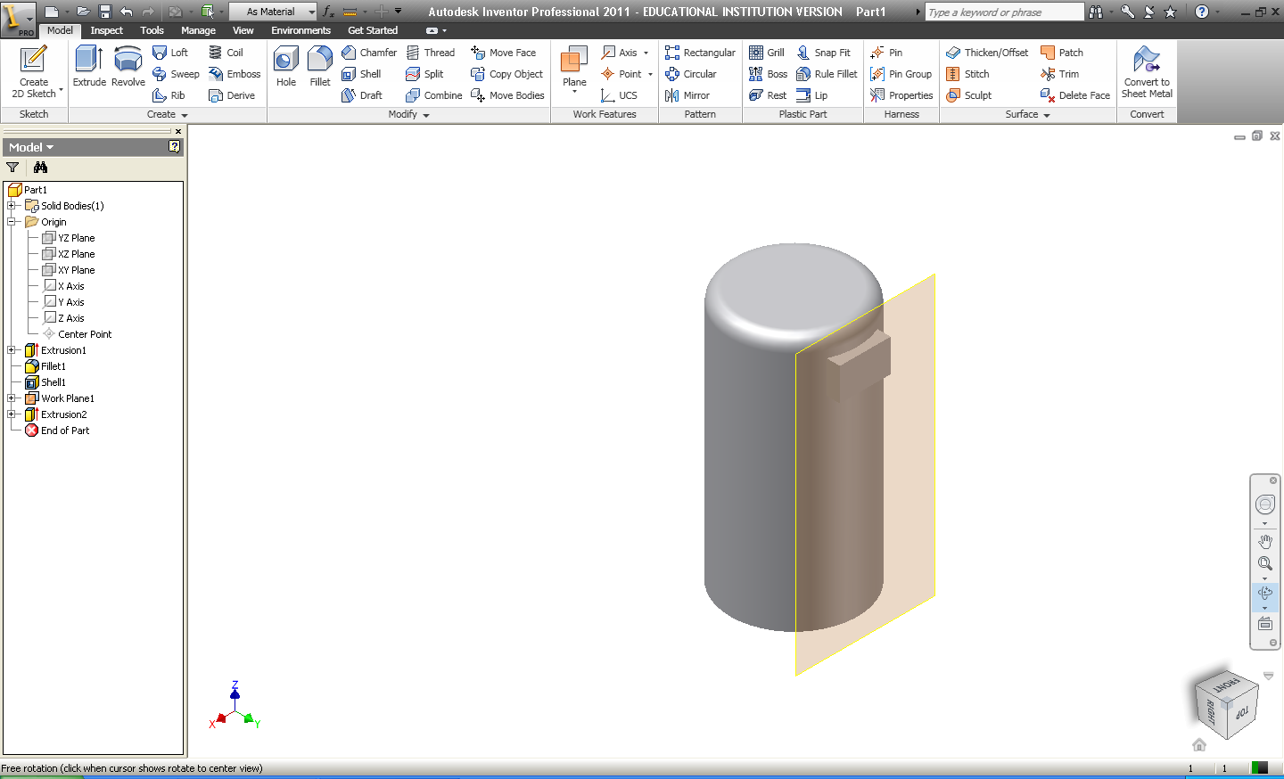
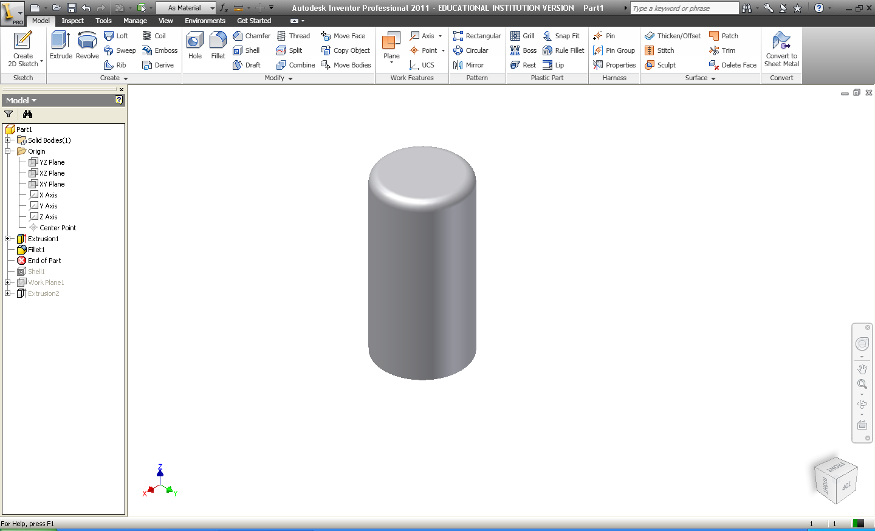
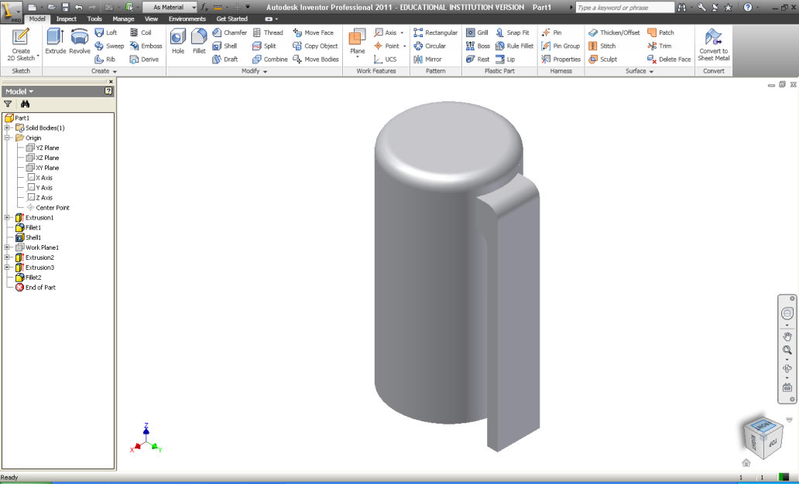
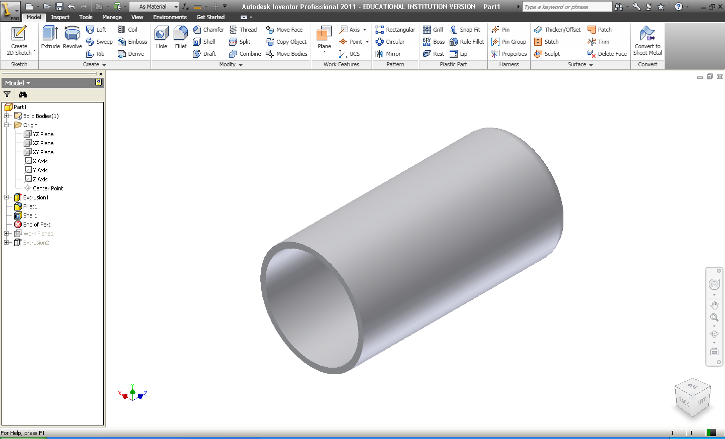
Exercise 1
The marker lid opposite was constructed on CAD software. Answer the following questions to explain how it was created.
After the initial sketch of a circle was created, state which tool was used to transform it in to the 3D object shown on the right:
Tool:
…………………………………………………
Next, the top edge of the cylinder was rounded to make it look more realistic, as shown on the right. What tool was used for this process:
Tool:
…………………………………………………
The cylinder was rotated upside down and hollowed out (as shown opposite) to allow space for the main body of the pen to fit inside. What tool was used for this process:
Tool:
…………………………………………………
To attach on the clip, we had to create a flat area for us to sketch on, this is shown in the diagram opposite. What is the name of this feature:
Feature: ……………………………………….
5. Using the space below, describe how the clip was created and modified:
……………………………………………………………………………………………………………………………………………………………………………………………………………………………………………………………………………………………………………………………

Slide 3
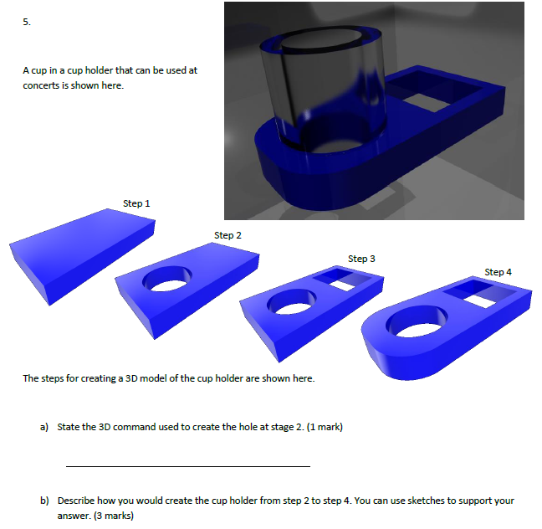

Slide 4
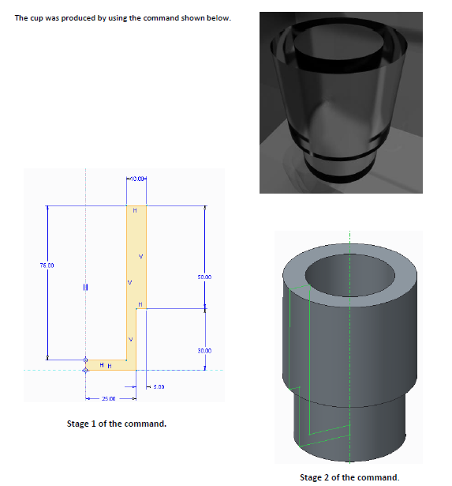
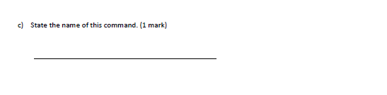

Slide 5
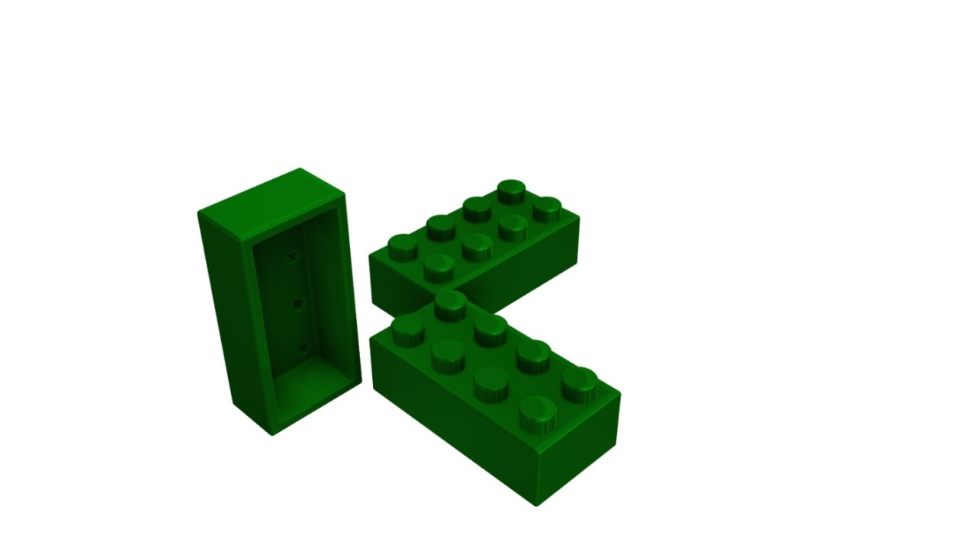
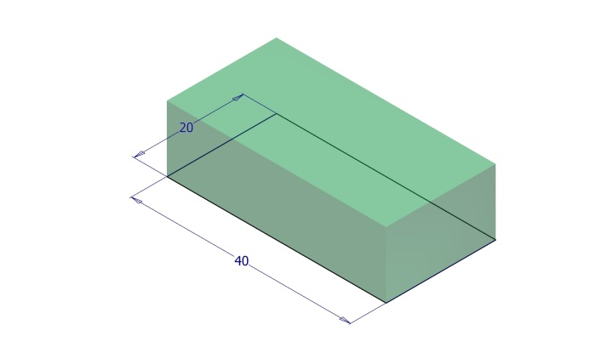
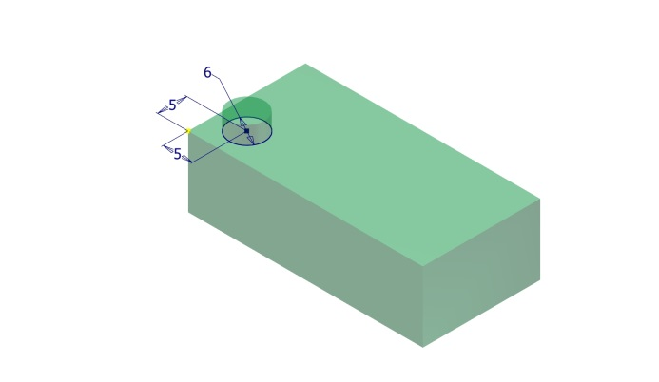
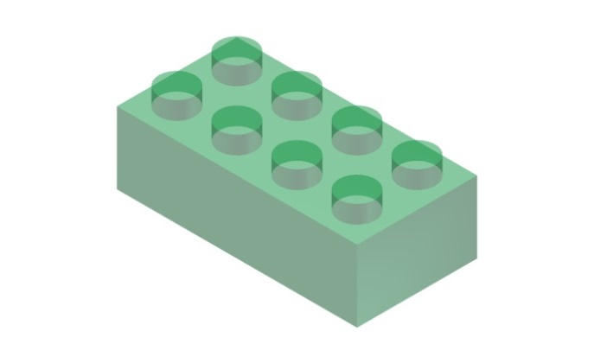
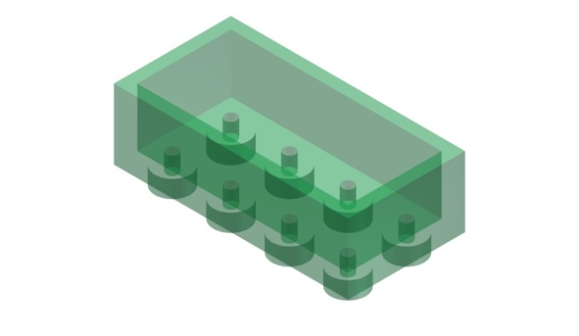
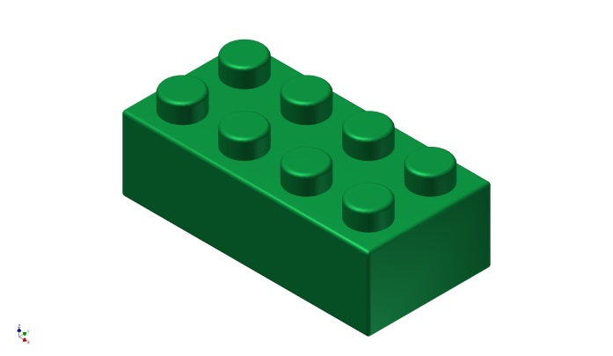
Exercise 2
Here’s a standard, 2x4 Lego© brick
Show how much you know about the CAD modelling process by writing a set of instructions to go with the five images here.
1.
2.
3.
4.
5.

Slide 6
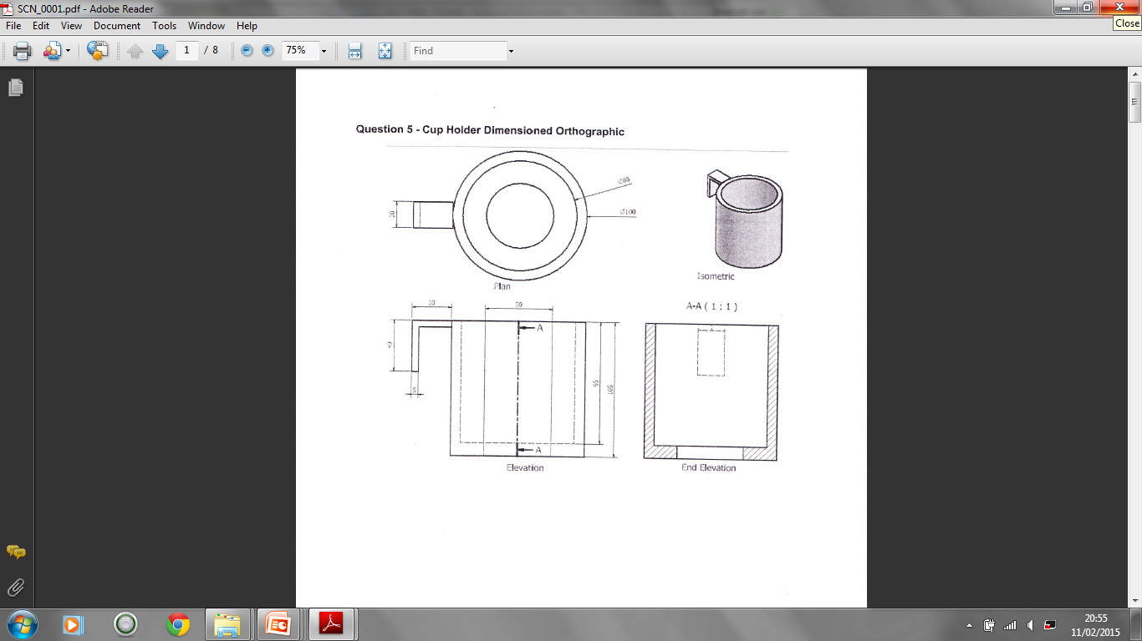

Slide 7
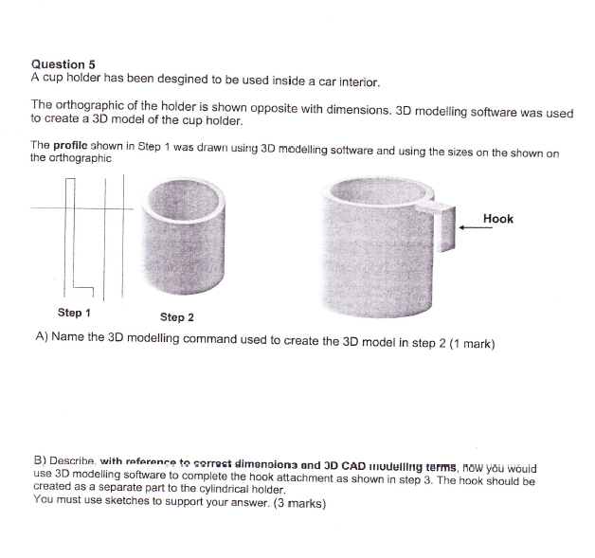

Slide 8
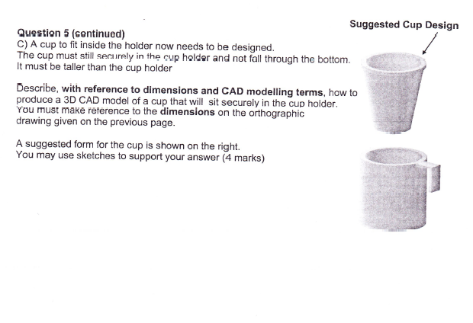

Slide 9
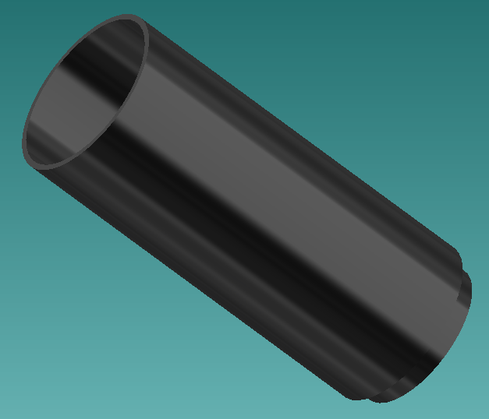
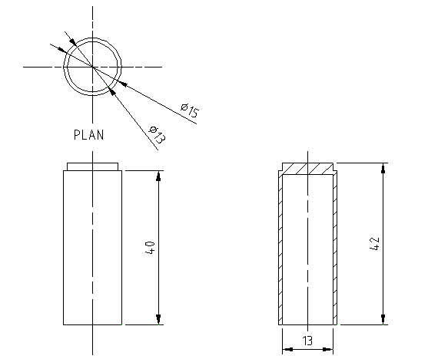
Refer to these illustrations and sketches when answering the questions on the next page.
The top of a board marker, the sketch from which it was created and the steps used in its creation are
shown below. It was created using 3D modelling software.
X
Sketch

Slide 10
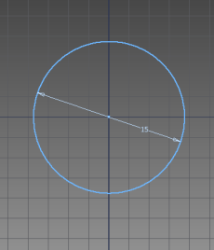
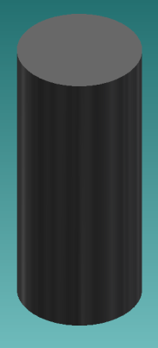
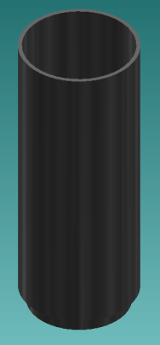
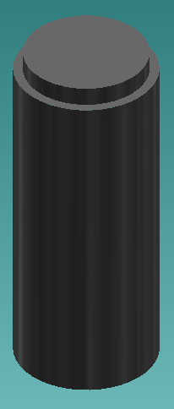
With reference to dimensions from the previous page, describe the 3D CAD commands used at
each stage of the modelling process.
Step 1
Step 2
Step 3
X
Step 4

Slide 11
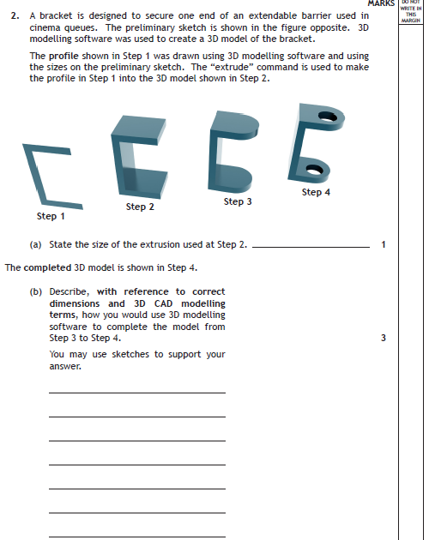

Slide 12
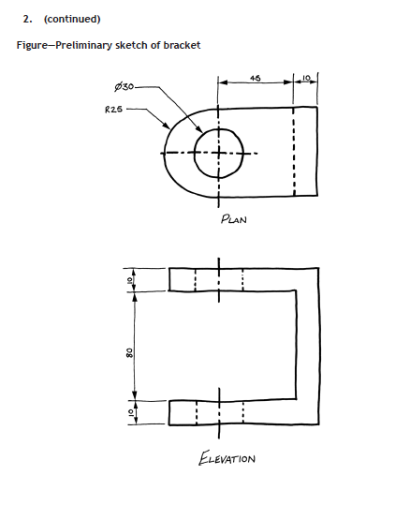

Slide 13
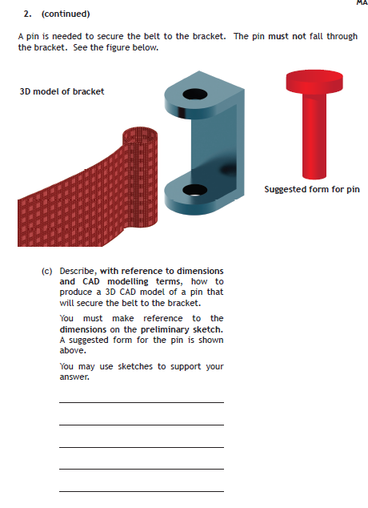
4 Marks

Slide 14
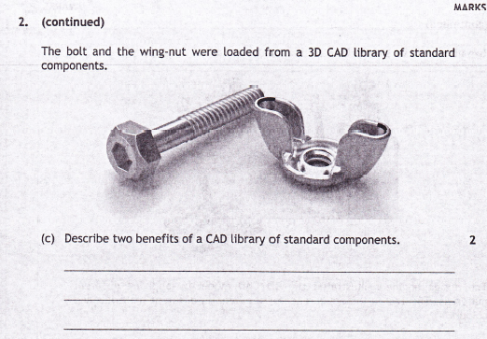
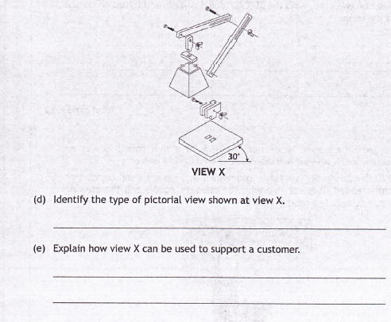

Slide 15
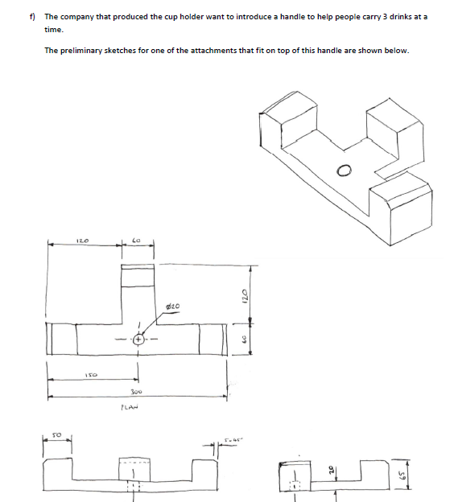
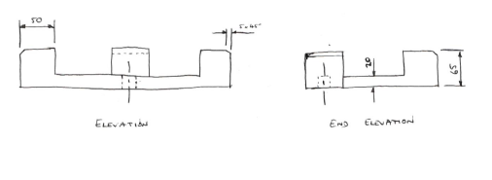

Slide 16
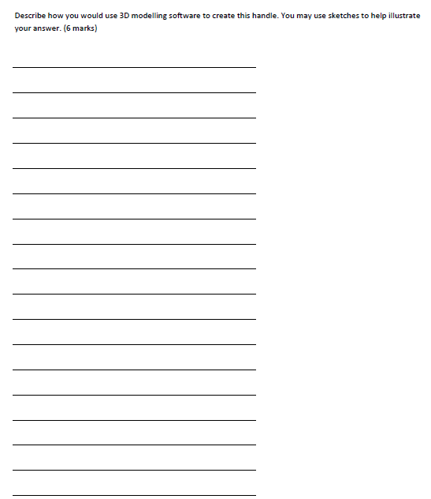

Slide 17
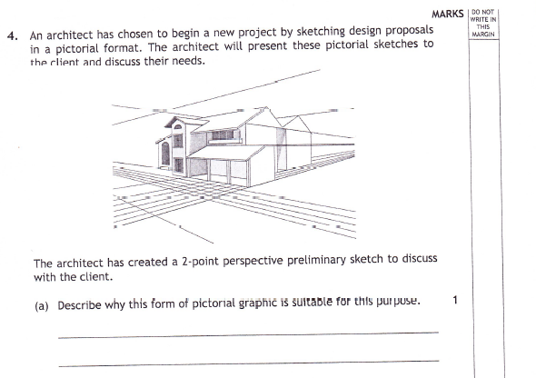
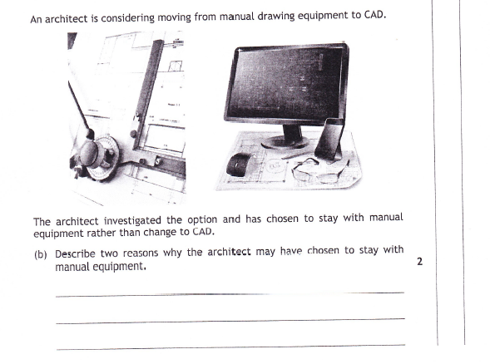

Slide 18
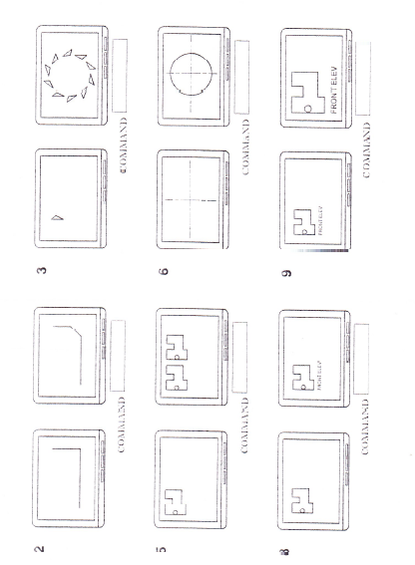
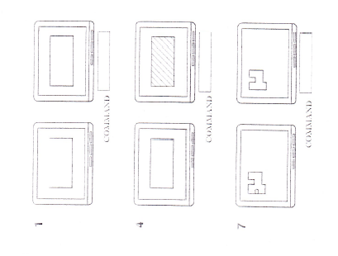
State the single CAD command used in each case.

Slide 19
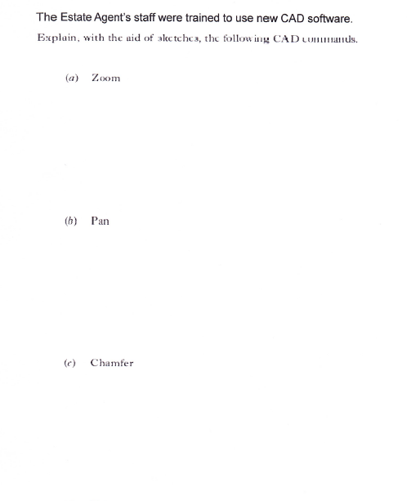
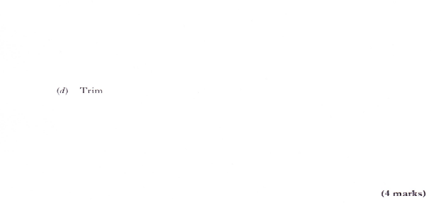

Slide 20
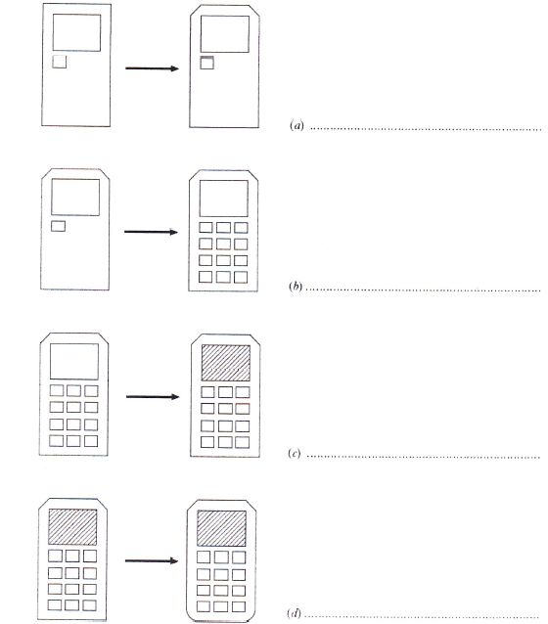
As a training exercise, staff at an engineering firm had to draw a simple calculator using basic CAD commands.
Identify the simple CAD command used to produce each stage

