Slide 1
N5
Name: ____________
Class: ____________
Teacher: ____________
EXAM
Revision
Drawing Standards, Protocols and Conventions

Slide 2
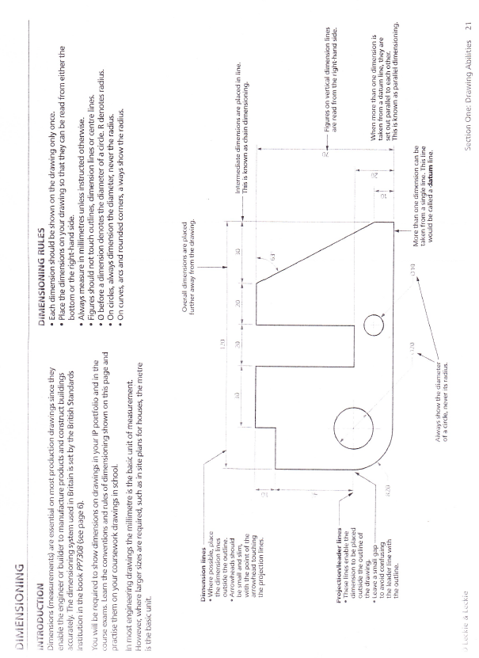

Slide 45
