Slide 1
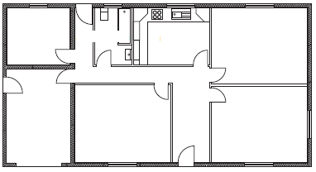
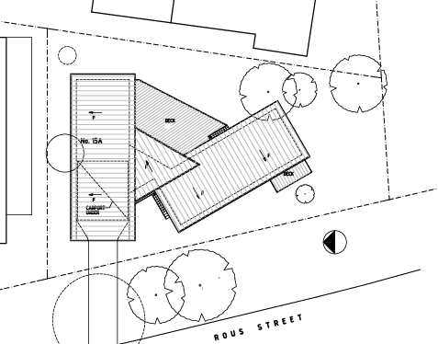
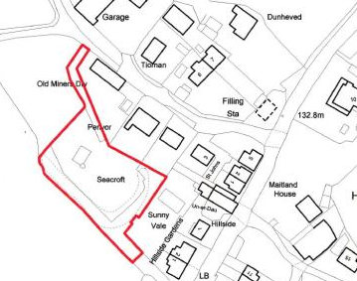
Construction Drawings
&
Symbols

Slide 2
Types of Plans
Location Plan
Site Plan
Floor Plan
Shows the surrounding housing
and environment in the immediate
area close to the proposed site.
Shows trees, contour lines
and boundaries related to
the proposed plot site.
Used by builders, plumbers, bricklayers, electricians and joiners.
Scale- 1:1000 or 1:1500
Scale- 1:200
Scale- 1:50

Slide 3
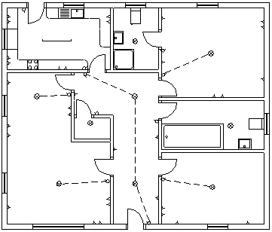
North Pointing Arrow
North Pointing
Arrow
How many windows
face East?

Slide 4
Symbols
Sectional Views
Floor plans
Schematics
Radiator
Switch
Bath
Socket
In Line
Valve
Brick
WC
(water closet)
Lamp
Shower
Tray
Crossover
Insulation
Fluorescent
Lamp
Junctions
Door
Wash
Basin
Sawn Timber
Concrete
Window
Sink Top
(R/H bowl)

Slide 5
Advantages/ Disadvantages
Advantages | Disadvantages
Symbols can be stored in CAD Library which means Items can be retrieved and positioned each time they are required on a drawing. Standardisation which means symbols can be used and recognised internationally. Drawing speed- drawing are more accurate and can be produced quicker which benefits companies. | Cost of Software and cost to train staff Time it takes to train new staff Possible loss of data Needs compatible software to view on other PCs

Slide 6
Quick Test
Switch
North
Pointing Arrow
Brick
Sawn Timber
WC
(water closet)
Wash
Basin
Lamp

Slide 7
Quick Test
Floor Plan
Site Plan
1:50
1:200
Location Plan
1:1000 or 1:1500

