Slide 1
Drawing Types

Slide 2
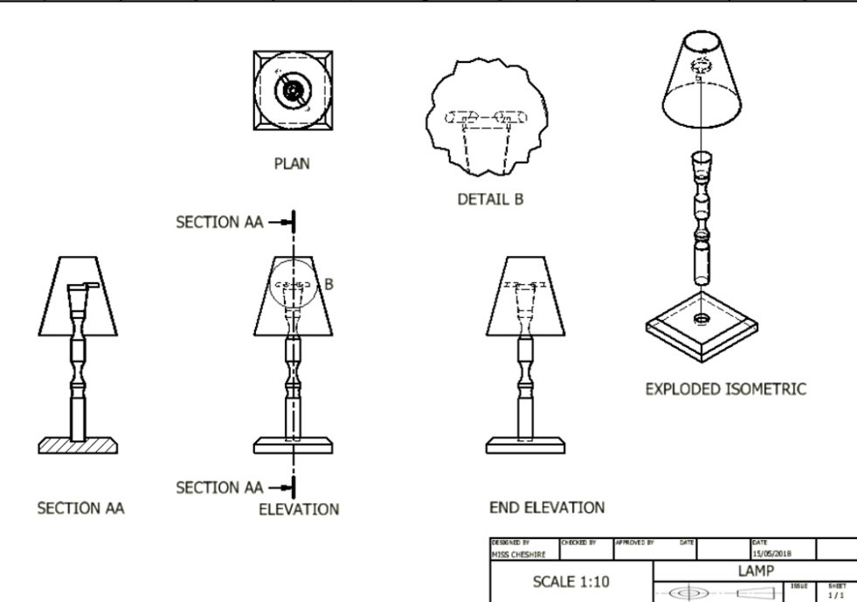
Orthographic

Slide 3
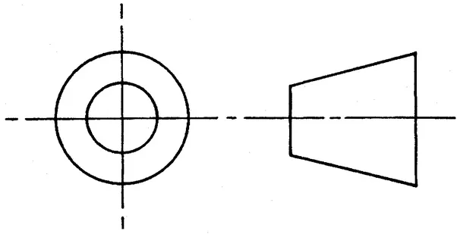
Orthographic
Must include
Additions
Elevation, end elevation and plan
Title views (elevation, end elevation and plan- these MUST be in capital letters.
Dimensions
Third angle projection symbol
Scale
Title box
Hidden detail lines
Centre lines
Sectional View
Enlarged Detail view
Exploded Isometric
Rendered 3D view

Slide 4
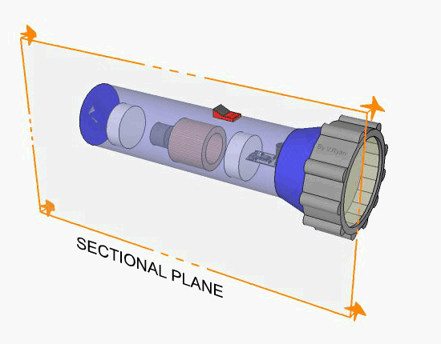
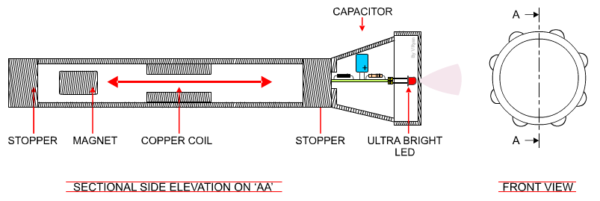
Sectional Views

Slide 5
Sectional Views
Sectional views are an aspect of orthographic drawing. A designer can use this technique to show the interior of a design.
An orthographic drawing of the torch is drawn on the bottom of the previous slide. It is comprised of a front view and a sectional side view. The centre line labelled ‘AA’ on the front view, shows where the ‘cut’ through the torch has been made. Any surfaces that have been cut have ‘hatched’ lines. This sectional view reveals the interior of the torch, making possible for the manufacturer to understand how the torch and its parts go together.

Slide 6
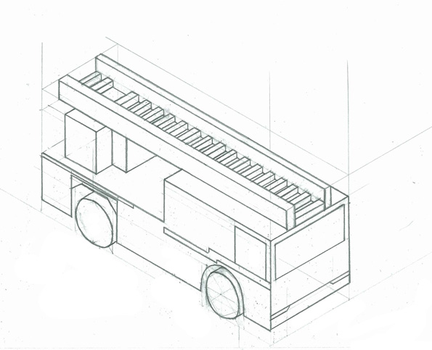
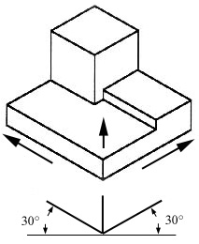
Isometric
Isometric drawings are 3D drawings drawn at a 30/60˚ angle.

Slide 7
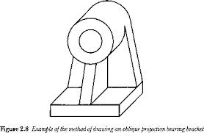
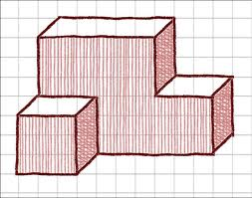
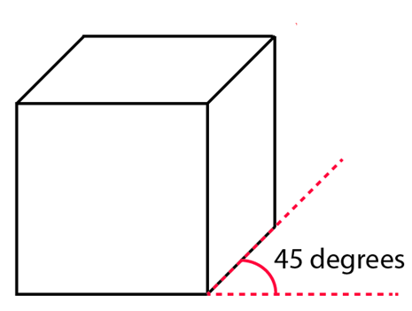
Oblique
Oblique drawings are drawing using a 45° angle. Any sizes that are drawn across the 45° angle are halved.

Slide 8
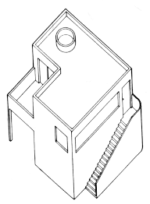
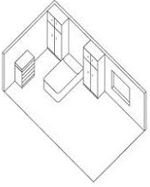
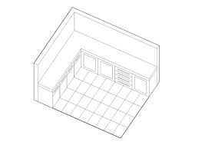
Planometric
A planometric drawing is a type of three dimensional drawing that includes an accurate ‘plan view’ or top view of a single plane, like a floor plan.

Slide 9
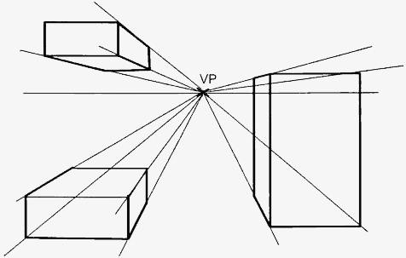
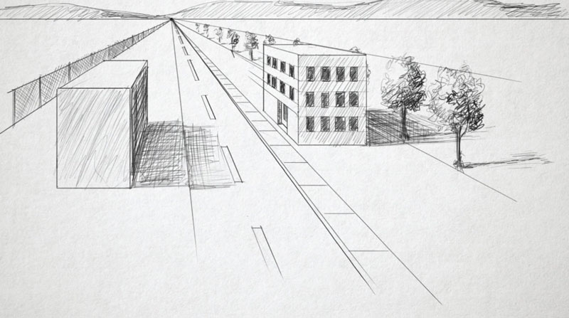
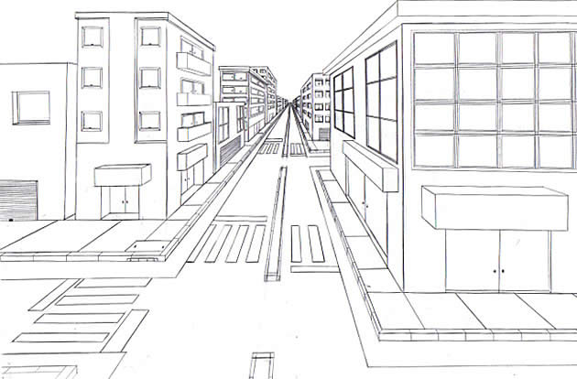
1pt Perspective
One point perspective is a drawing method that shows how things appear to get smaller as they get further away, converging towards a single 'vanishing point' on the horizon line.

Slide 10
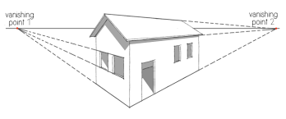
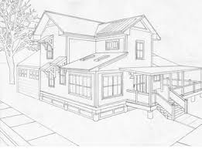
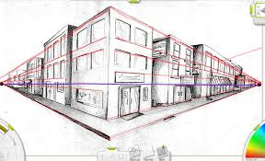
2pt Perspective
Two point perspective drawing is a type of linear perspective. Linear perspective is a method using lines to create the illusion of space on a 2D surface. ... Each form of linear perspective is named for the number of vanishing points used in the drawing. Therefore, two point perspective uses two vanishing points.

Slide 11
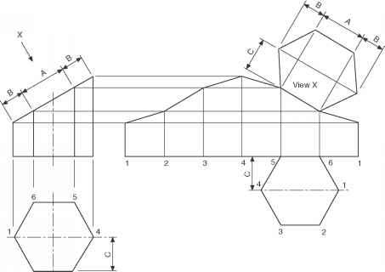
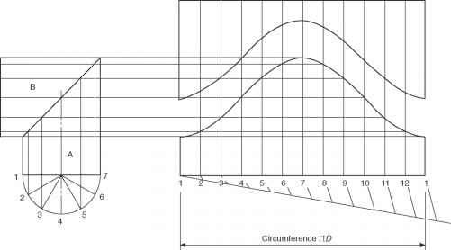
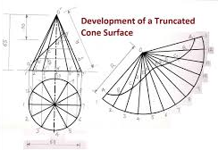
Development

Slide 12
Development
Development of surfaces. A development is the unfold / unrolled flat / plane figure of a 3-D object. It is also called a pattern where the plane may show the true size of each area of the object. When the pattern is cut, it can be rolled or folded back into the original object.

