Slide 1
Colour Theory

Slide 2
The colour wheel
The colour wheel is designed in a way to show how colours relate to each other.
There are 3 layers of the colour wheel.

Slide 3
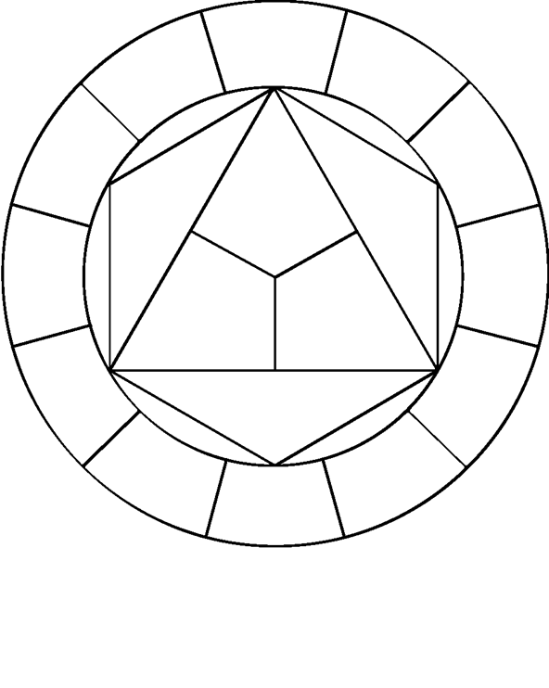
The colour wheel
YELLOW
The inside 3 colours are referred to as PRIMARY COLOURS. These colours work in various combinations to create all the other colours.
RED
BLUE

Slide 4
The colour wheel
GREEN
ORANGE
The next layer of the colour wheel are SECONDARY COLOURS. These are made up of mixing equal parts of TWO PRIMARY COLOURS.
VIOLET

Slide 5
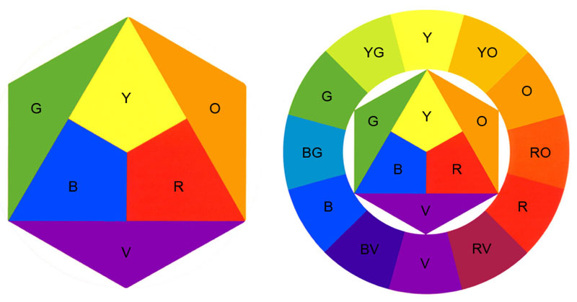
The colour wheel
The final, outer layer of the colour wheel is filled with Tertiary colours. These are made of a SECONDARY and a PRIMARY colour. They therefore take their name from the two colour; eg yellow and green make yellow-green.

Slide 6
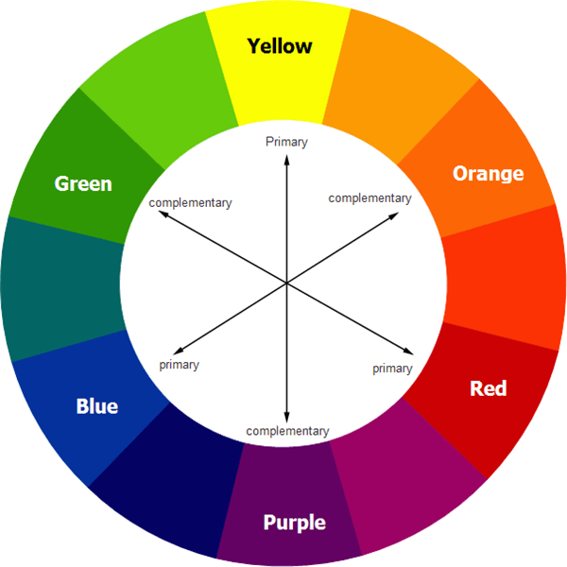
Contrast/Harmony
CONTRAST- Colours that are far apart from each other on the colour wheel are known as contrasting colours.
Contrast is eye-catching and makes objects stand out.

Slide 7
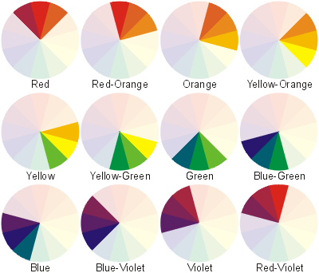
Contrast/Harmony
HARMONY- Colours close to each other on the colour wheel on the outside of the colour wheel. Harmony is easy on the eyes.

Slide 8
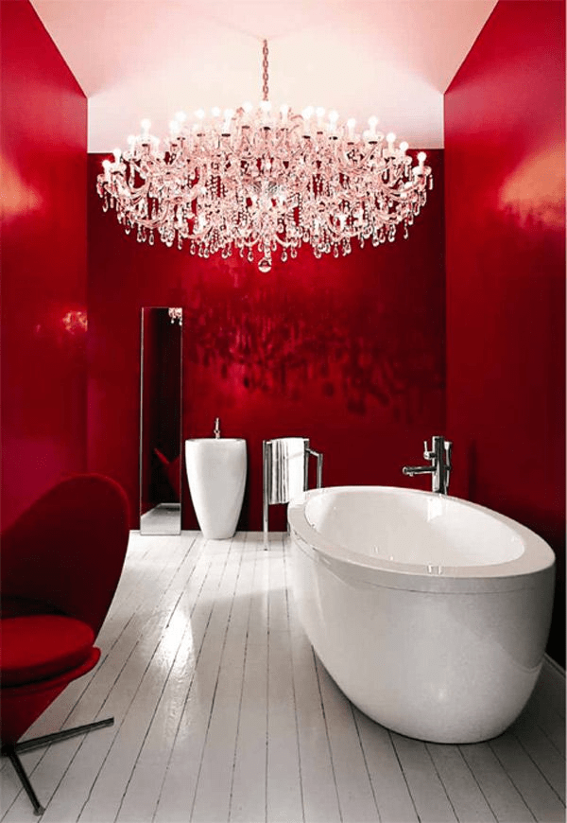

Slide 9
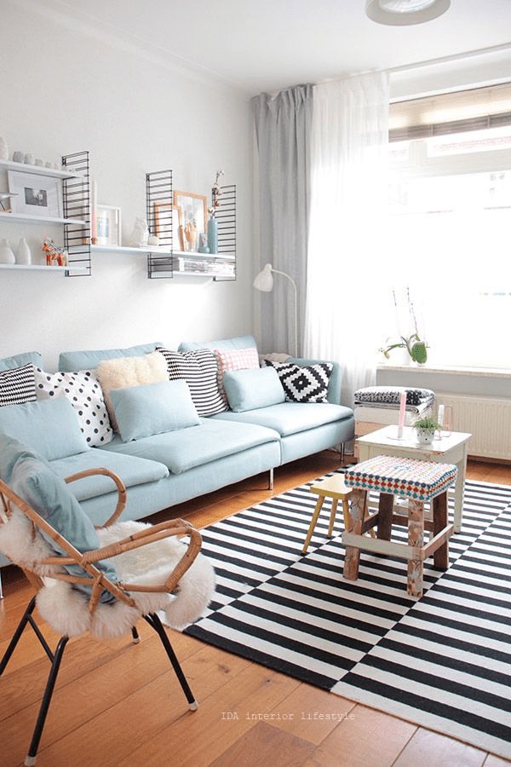

Slide 10
Warm vs Cool
Colours can also fall under being ‘warm’ or ‘cool’.
Warm Colours
Cool Colours
Evoke feelings of warmth.
They are also known as ADVANCING COLOURS because they appear closer to the viewer than other colours.
Warm colours are;
Reds
Yellows
Oranges
Evokes feelings of being cold. They are known as RECEDING COLOURS as they appear further away.
Cool colours are;
Blues
Greens
Violets

Slide 11
Terms
HUE- The basic colour
TONE- Lighter or darker than the basic colour
TINT- The basic hue mixed with some white
SHADE- The basic hue mixed with some black

Slide 12
Colour Gradients
When a colour moves through a variety of tones from light to dark, this is termed a gradient. This effect is used a lot to give the impression that an object is three dimensional.
Gradients can be stepped like the first example here or they can be more gradual as shown in the second.

Slide 13
Great power of attraction but too much can be tiring. Hot, bold, exciting, festive, passionate, positive. Red can be associated with rage, aggression, danger, courage, masculinity and speed.
RED
YELLOW
The colour which is most easily seen (luminous). Bright, pleasant, happy, sunny, lively and cheerful. Yellow is often associated with sunshine and holidays.
BLUE
Blue is more formal than red or yellow. Cool, sophisticated, aristocratic, serene, passive, elegant and reliable. Rarely used in food because of its association with mould. Associated with reliability
ORANGE
Sunny, cheerful, warm and happy. Orange is one of the appetite colours associated with flavour, energy and vitality.
GREEN
Green is the most restful of all of the colours. Fresh, youthful, cool, soothing, natural and informal. It is also associated with safety, health and environmental concern.

Slide 14
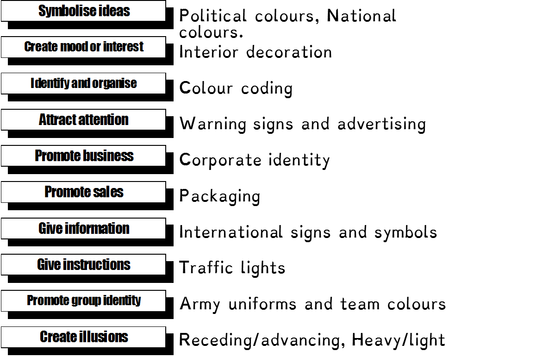
Some functions of colour

Slide 15
In Graphic Communication we use colour extensively. However, we do not simply use it for the sake of using it. We use it for specific purposes. We select certain colours to render, design and tone products to suit the individual environment.

Slide 16
Colour Association
We are surrounded by colours everywhere and colours are involved in everything we do, both consciously and sub-consciously. In the following few slides we will take a look at what certain colours mean to us and how they are manipulated in every day life. . .

Slide 17
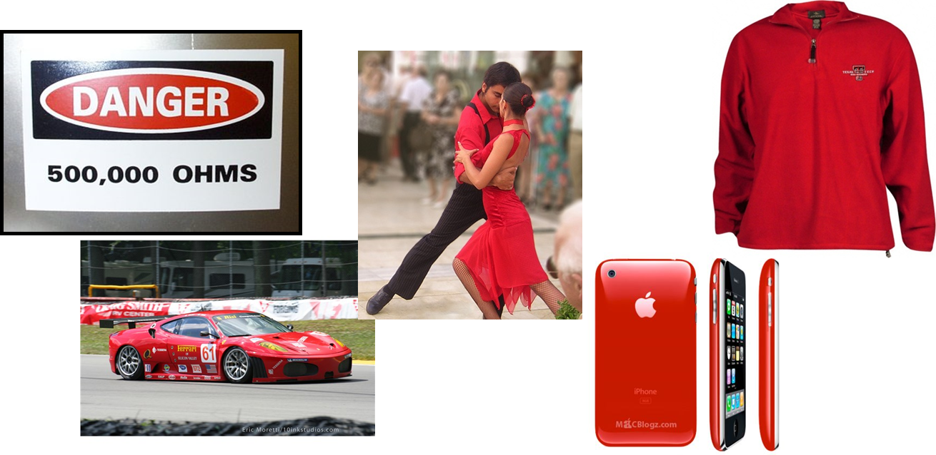
RED
Red is associated with areas such as passion, danger, speed, stopping, blood, fear and warmth. Certain items will be coloured red due to this colour association.

Slide 18
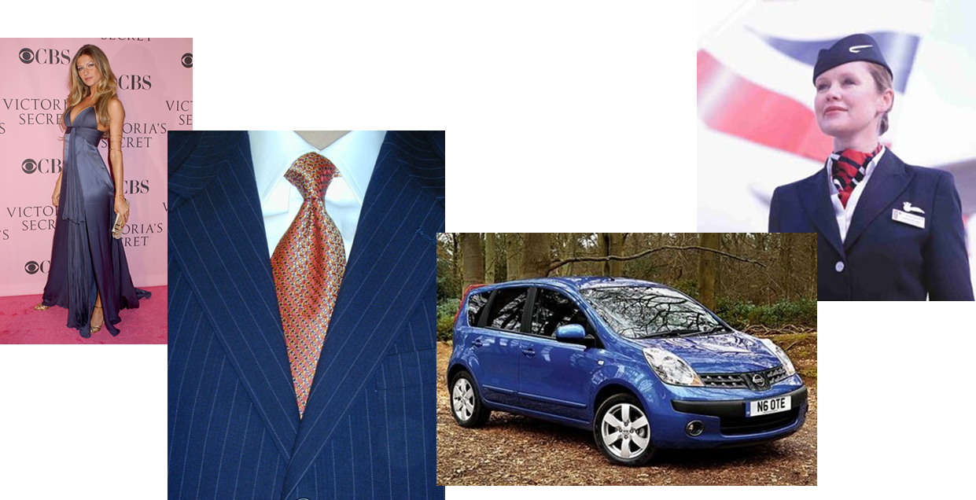
BLUE
Blue is a formal colour, it is associated with sophistication, elegance and reliability. It is a cool colour which is rarely used in foods as it is associated with mould! For this reason, chef’s sticking plasters are blue.

Slide 19
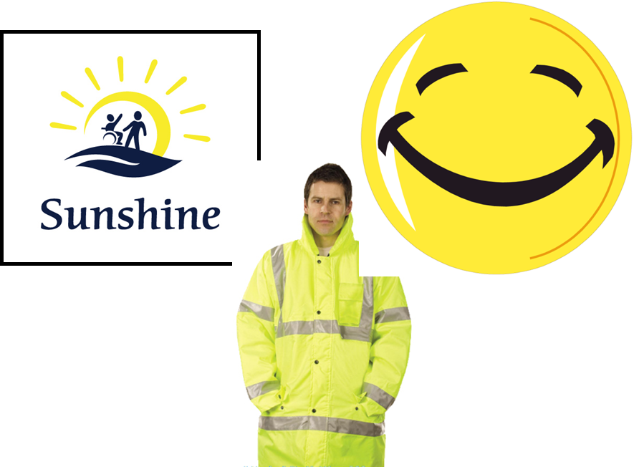
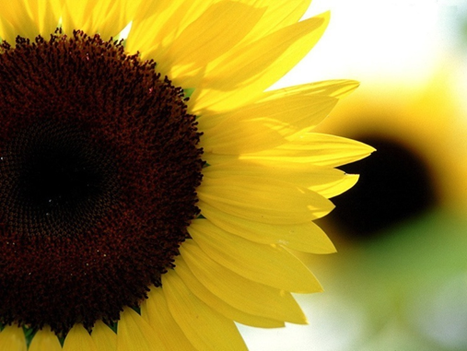
YELLOW
Yellow is an easily seen, luminous colour. It is associated with brightness, sunshine, holidays, being happy and cheerful.

Slide 20
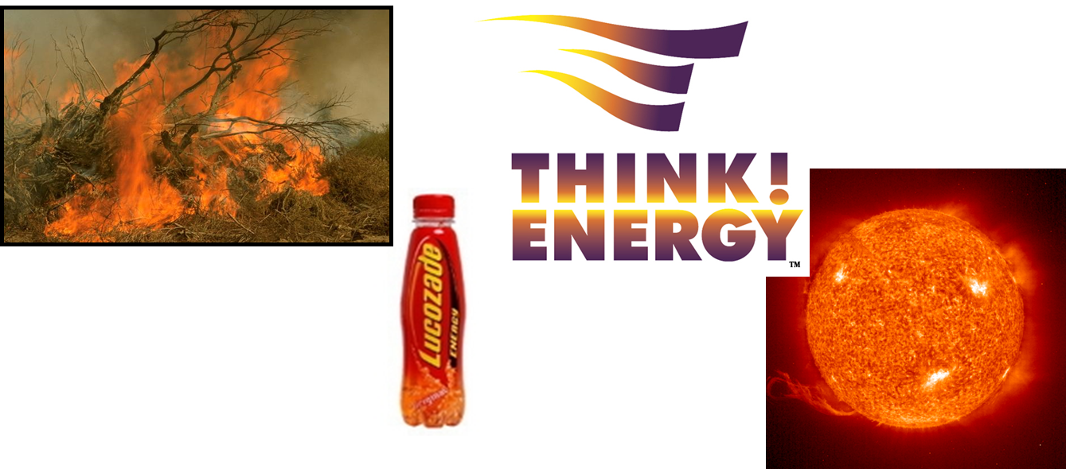
ORANGE
Orange is similar to yellow in its associations. Orange is linked with areas such as warmth, fire, sun, being happy, cheerful and is also associated with flavour and energy.

Slide 21
GREEN
Green is a very restful and peaceful colour. It is associated with areas such as nature, health, the environment, informal, youthful and cool.

Slide 22
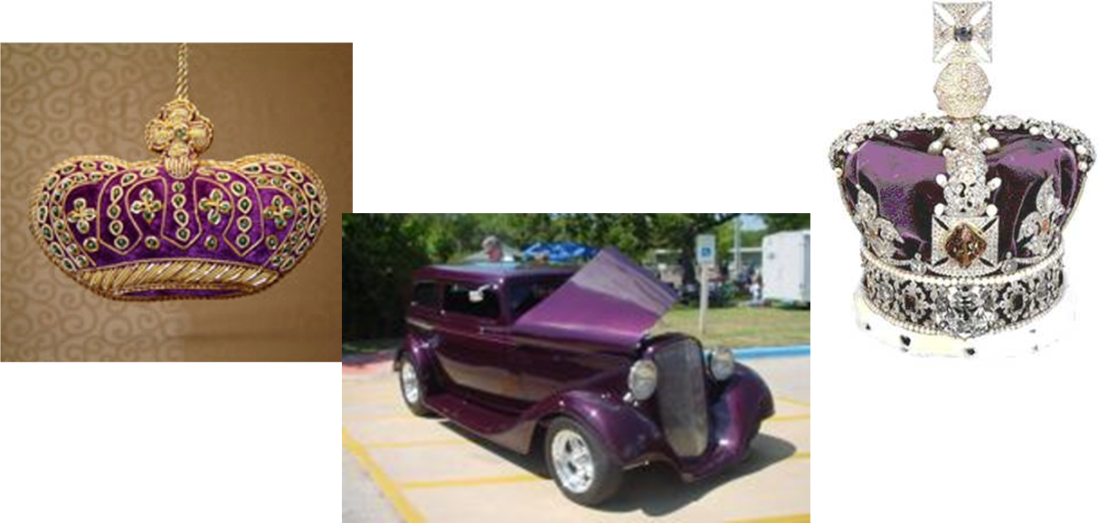
PURPLE
Purple combines the courage of red and the nobility of blue. It is a rich, pompous, impressive and regal colour.

Slide 23
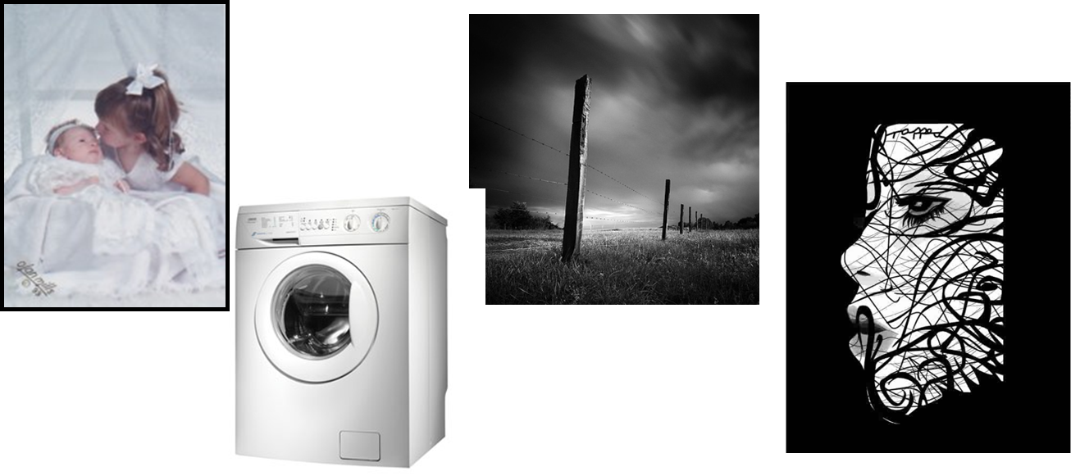
WHITE
White is luminous, positive, light, delicate and clean. It is also associated with innocence and purity in our culture but with death in some other cultures. When used with black it gives a dramatic effect.

Slide 24
BLACK
Black is very subdued, solemn, profound, it is associated with death, sorrow and evil in our culture. Used with white it is very dramatic.

